Slide 1
GAPS MODEL OF SERVICE QUALITY

Slide 2
Definition of service
Berry define service as act, deeds, & performance.
AMA define service as activities, benefits or satisfaction that are offered for sale, or provided in connection with the sale of goods.

Slide 3
Performed by..
People, machine, people with
machine
Service is…
an
activity
Deed,
Performance
Efforts.
Rendered by…
profit,
Non profit
Service
Directed at….
people and
Business users

Slide 4
What is quality
In the words of crosby:-Quality is conformance to requirements
ASQC Define:- Quality is the totality of features and characteristics of a product, or service that bear on it’s ability to satisfy stated or implied needs.
Fully satisfy customer requirements at the lower cost.

Slide 5
What is service quality?
An assessment of how well a delivered service conforms to the client's expectations. Service business operators often assess the service quality provided to their customers in order to improve their service, to quickly identify problems, and to better assess client satisfaction.

Slide 6
What is service quality?
Expected
service
Service
quality
Customer
satisfaction
Customer
loyalty
Perceived
service

Slide 7
GAPS MODEL OF SERVICE QUALITY

Slide 8
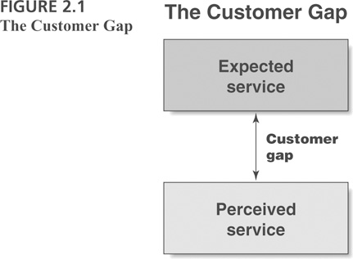
The Customer Gap

Slide 9
The Gaps Model was proposed by A Parasuraman, Valarie Zeithaml and LL Berry in 1985 in the Journal Of Marketing

Slide 10
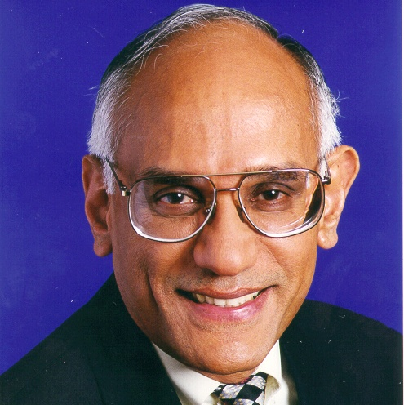
Professor A. Parasuraman

Slide 11

Dr. Valarie Zeithaml

Slide 12

Dr. Leonard L. Berry

Slide 13
Customer gap:
  Difference between expectations and perceptions
Provider gap 1:
  Not knowing what customers expect
Provider gap 2:
  Not selecting the right service designs and standards
Provider gap 3:
  Not delivering to service standards
Provider gap 4:
  Not matching performance to promises

Slide 14
Provider Gap 1
CUSTOMER
Expected Service
GAP 1
COMPANY
Company Perceptions of Consumer Expectations

Slide 15
GAP 1
Wi tribe: Was not offering usb dongle internet
Pizza hut: Was not offering Lemon pie and brownies
HBL: No online payment services
Ufone: Was not offering internet services
Apcoms: No management degree in start

Slide 16
Reasons
for
provider
gap
I
Customer’s expectations
Inadequate marketing research orientation
Lack of upward communication
Insufficient relationship focus
Inadequate service recovery
Company’s perceptions of customer expectations

Slide 17
Key Factors Leading to Provider Gap 1
Customer Expectations
GAP
1
Company Perceptions of Customer Expectations

Slide 18
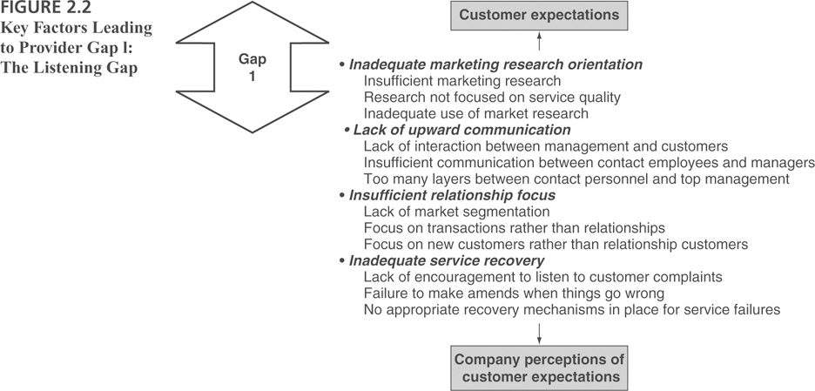
Key Factors Leading to Provider Gap 1

Slide 19
Provider Gap 2
CUSTOMER
COMPANY
Customer-Driven
Service Designs and Standards
GAP 2
Company Perceptions of Consumer Expectations

Slide 20
GAP 2
Wi tribe: It then started usb dongle but not up to standard
Pizza hut: Started offering Lemon pie and brownies but not of high quality
HBL: Started offering online payment but not of excellent quality
Ufone: started offering low quality internet services
Apcoms: Started offering management degree but not HEC recognized

Slide 21
Translation of perceptions into service quality specifications
Reasons
for
provider
gap
2
Poor service design
Absence of customer-defined service standards
Inappropriate physical evidence and services cape
Management perceptions of customer expectations

Slide 22
Key Factors Leading to Provider Gap 2
Customer-Driven Service Designs and Standards
GAP
2
Management Perceptions of Customer Expectations

Slide 23
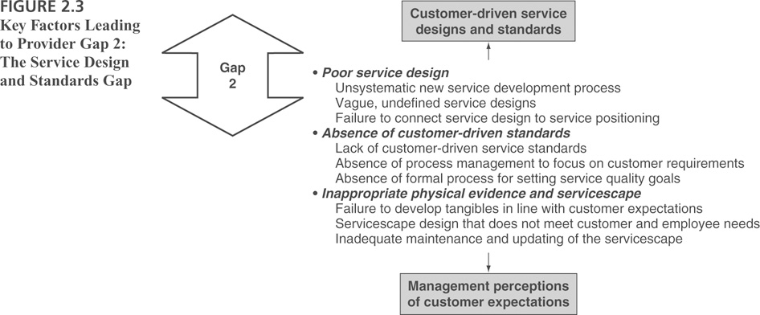
Key Factors Leading to Provider Gap 2

Slide 24
Provider Gap 3
CUSTOMER
COMPANY
Service Delivery
GAP 3
Customer-Driven
Service Designs and Standards

Slide 25
GAP 3
Wi tribe: no user guide given by Customer officer
Pizza hut: Unavailability of dessert
HBL: Not on time
Ufone: CSR is not much informed regarding service details
Apcoms: Teachers were not highly qualified

Slide 26
Reasons
for
provider
gap
3
Customer-driven service designs and standards
Poor human resource policies
Failure to match supply and demand
Customer not fulfilling their roles
Problems with service intermediaries
Service delivery

Slide 27
Key Factors Leading to Provider Gap 3
Customer-Driven Service Designs and Standards
GAP
3
Service Delivery

Slide 28
Provider Gap 4
CUSTOMER
Service Delivery
External Communications to Customers
COMPANY
GAP 4

Slide 29
GAP 4
Wi tribe: excellent services but not exactly what it advertises
Pizza hut: it is good to eat but not as much as the mouth watering ad seems to be
HBL: delivered service is good but not exactly the same as depicted in ads
Ufone: Really good but not exactly according to ads
Apcoms: It is good but not as much shown in advertisements

Slide 30
External communications to consumers
Reasons
for
provider
gap
4
Lack of integration of marketing communications
Inadequate management of customer expectations
Overpromising
Inadequate horizontal communications
Service delivery

Slide 31
Key Factors Leading to Provider Gap 4
Service Delivery
GAP
4
External Communications to Customers

Slide 32
The Services Marketing Triangle
Company
(Management)
Internal Marketing
External Marketing
“enabling the
promise”
“setting the
promise”
Employees
Customers
“delivering the promise”
Interactive Marketing

Slide 33
Gaps Model of Service Quality
CUSTOMER
Expected Service
Customer
Gap
Perceived
Service
COMPANY
Service Delivery
External Communications to Customers
Gap 4
Gap 1
Gap 3
Customer-Driven Service Designs and Standards
Gap 2
Company Perceptions of Consumer Expectations

Slide 34


Closing the gaps
Gap 1: Learn what customers expect
Gap 2: Establish the right service quality standards
Gap 3: Ensure that service performance meets standards
Gap 4: Ensure that delivery matches promises

Slide 35
Closing gap 1: Learn what customers expect
Use research, complaint analysis, customer panels
Increase direct interactions between managers and customers
Improve upward communications
Act on information and insights
listen to customers

Slide 36
Closing gap 2: Establish the right service quality standards
Top management commitment to providing service quality
Set, communicate, and reinforce customer-oriented service standards
Establish challenging and realistic service quality goals
Train managers to be service quality leaders
Be receptive to new ways to deliver service quality
Standardise repetitive tasks

Slide 37
Service Quality Awards
Prioritise tasks
Gain employee acceptance of goals and priorities
Measure performance of service standards and provide regular feedback
Reward managers and employees for achievement of quality goals

Slide 38
Closing gap 3: Ensure that service performance meets standards
Can I take your order?
Attract the best employees
Select the right employees
Develop and support employees
  train employees
  provide appropriate technology & equipment
  encourage and build teamwork
  empower employees
  internal marketing

Slide 39

You are a
Star Service
Provider
Retain good employees
  measure and reward service quality achievements
  develop equitable and simple reward systems

Slide 40
Closing gap 4: Ensure that service delivery matches promises
Seek input from operations personnel on what can be done
‘Reality’ advertising
  real employees, real customers, real situations
Seek input from employees on advertising
Gain communications between sales, operations and customers
Internal marketing programs

Slide 41
Ensure consistent standards in multi-site operations
In advertising, focus on service characteristics that are important to customers
Manage customer’s expectations
  What are realistic expectations?
  Explain industry realities
Tiered service options
  Offer different levels of
  service - user pays
Why do we
always have
to wait?

Slide 42
Brief Summary Gaps in Service Quality
Gap | Problem | Cause(s)
1. Consumer expectation – mgmt. perception | The service features offered don’t meet customer needs | Lack of marketing research; inadequate upward communication; too many levels between contact personnel and management
2. Management perception – service quality specification | The service specifications defined do not meet management’s perceptions of customer expectations | Resource constraints; management indifference; poor service design
3. Service quality specification – service delivery | Specifications for service meet customer needs but service delivery is not consistent with those specifications | Employee performance is not standardized; customer perceptions are not uniform
4. Service delivery – external communication | The service does not meet customer expectations, which have been influenced by external communication | Marketing message is not consistent with actual service offering; promising more than can be delivered

Slide 43


